Slide 1
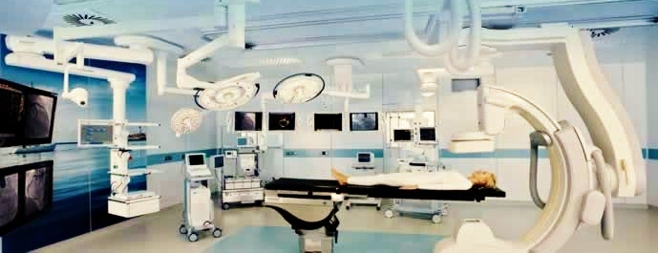
OPERATION THEATRE AUTOMATION & CONTROLLER
Shradha Shashidhar
Savitha Pareek
P.M.Sanjeev Kumar Under the Guidance of
Pavan.M.Sunder Mr. Naveen H.L

Slide 2
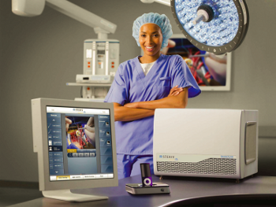
AGENDA
OTAC Overview
Block diagram
Master circuit
Individual circuits
Flowchart
Main program
Conclusion

Slide 3
OTAC Overview
We propose to design an automated operating theatre (OTAC) where all the things can be automated and can be monitored at regular basis.
In this module we suggest that we control and monitor the following features:
Intensity of the Lamps.
Operating bed level.
Controlled Anesthesia administration.
Blood agitator used while administering blood.
Switch enabled instrument selection mechanism.
Switch enabled drugs selection mechanism.
Temperature monitoring of the room.
Temperature monitoring of the patient body.
Voice based reminders.

Slide 4

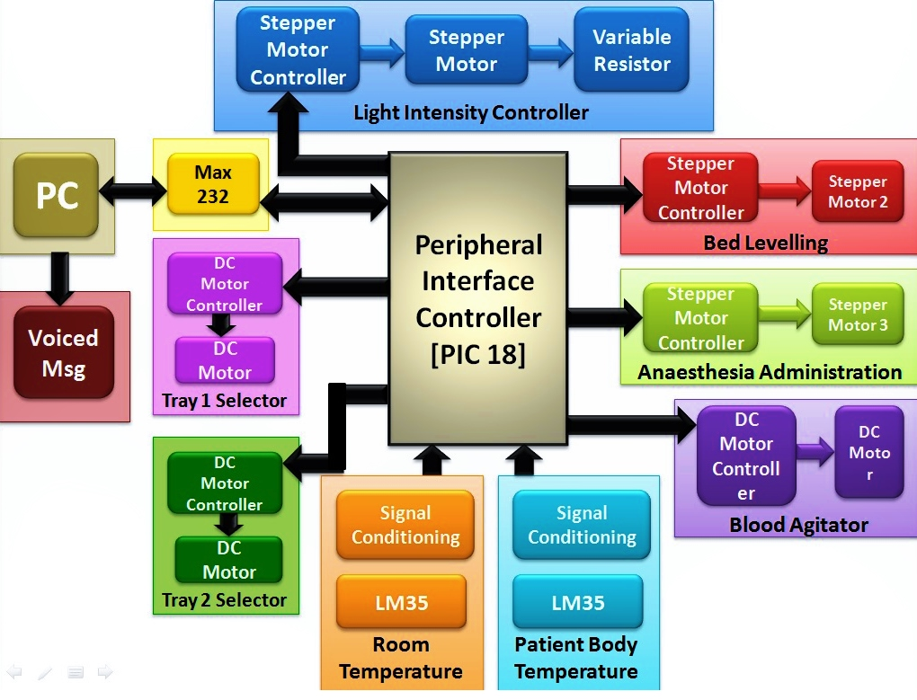
B L O C K D I A G R A M

Slide 5
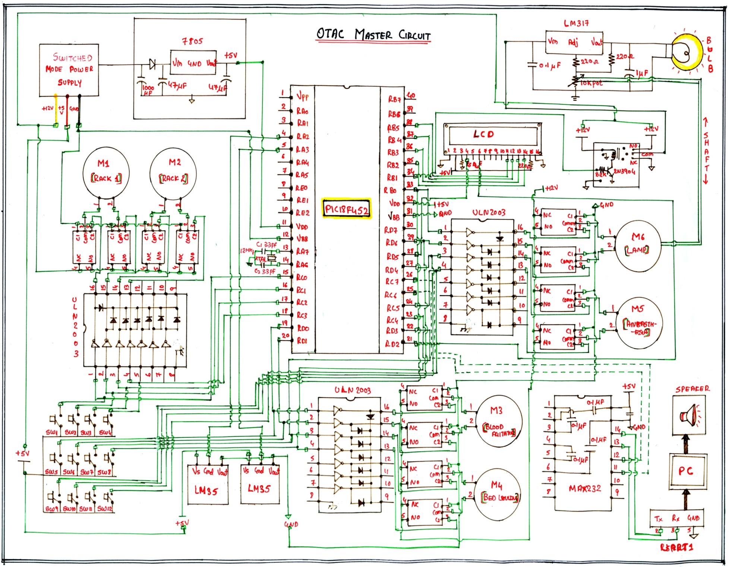
M A S T E R C I R C U I T

Slide 6
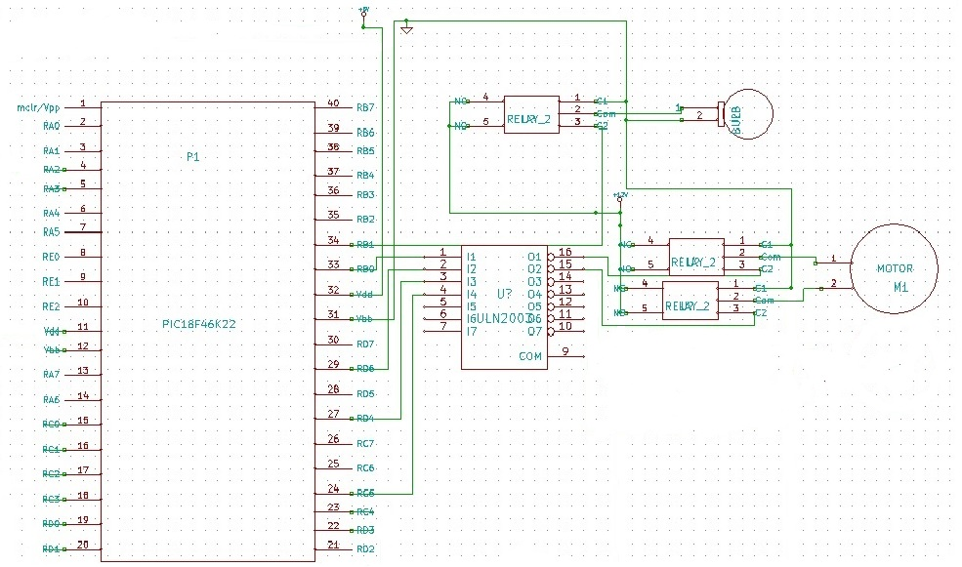
L
I
G
H
T
I
N
T
E
N
S
I
T
Y

Slide 7
C2
NC
Relay 2
Common
MC
C1
NO
12 V
LM 317
Vin Adj Vout
12 V
0.1 micro F
220 ohm
10k
10 micro F
Pot
Controlled by Stepper Motor

Slide 8
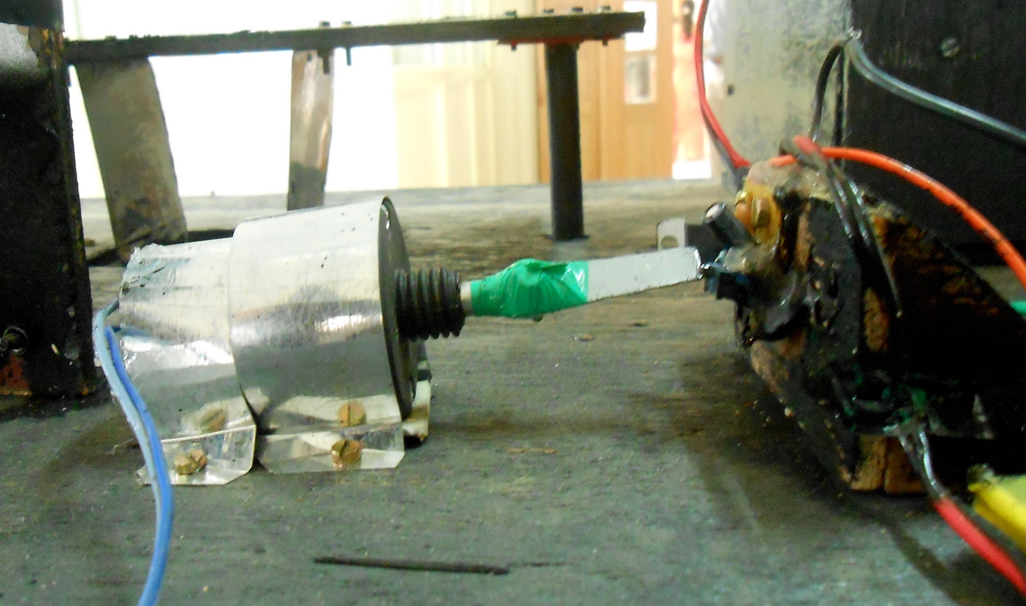

Slide 9
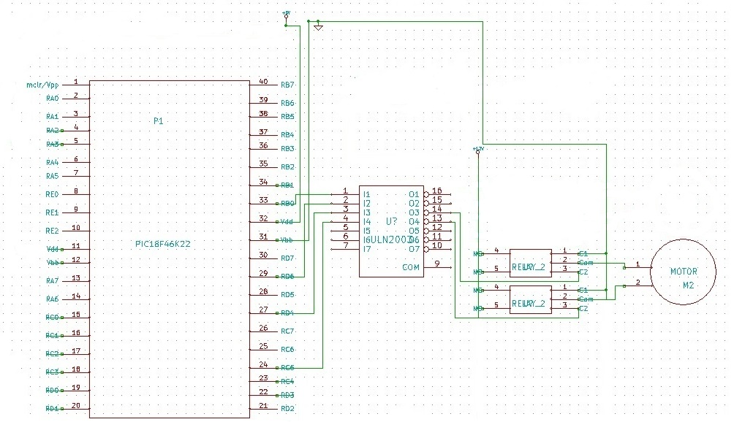
B
E
D
L
E
V
E
L
L
I
N
G

Slide 10
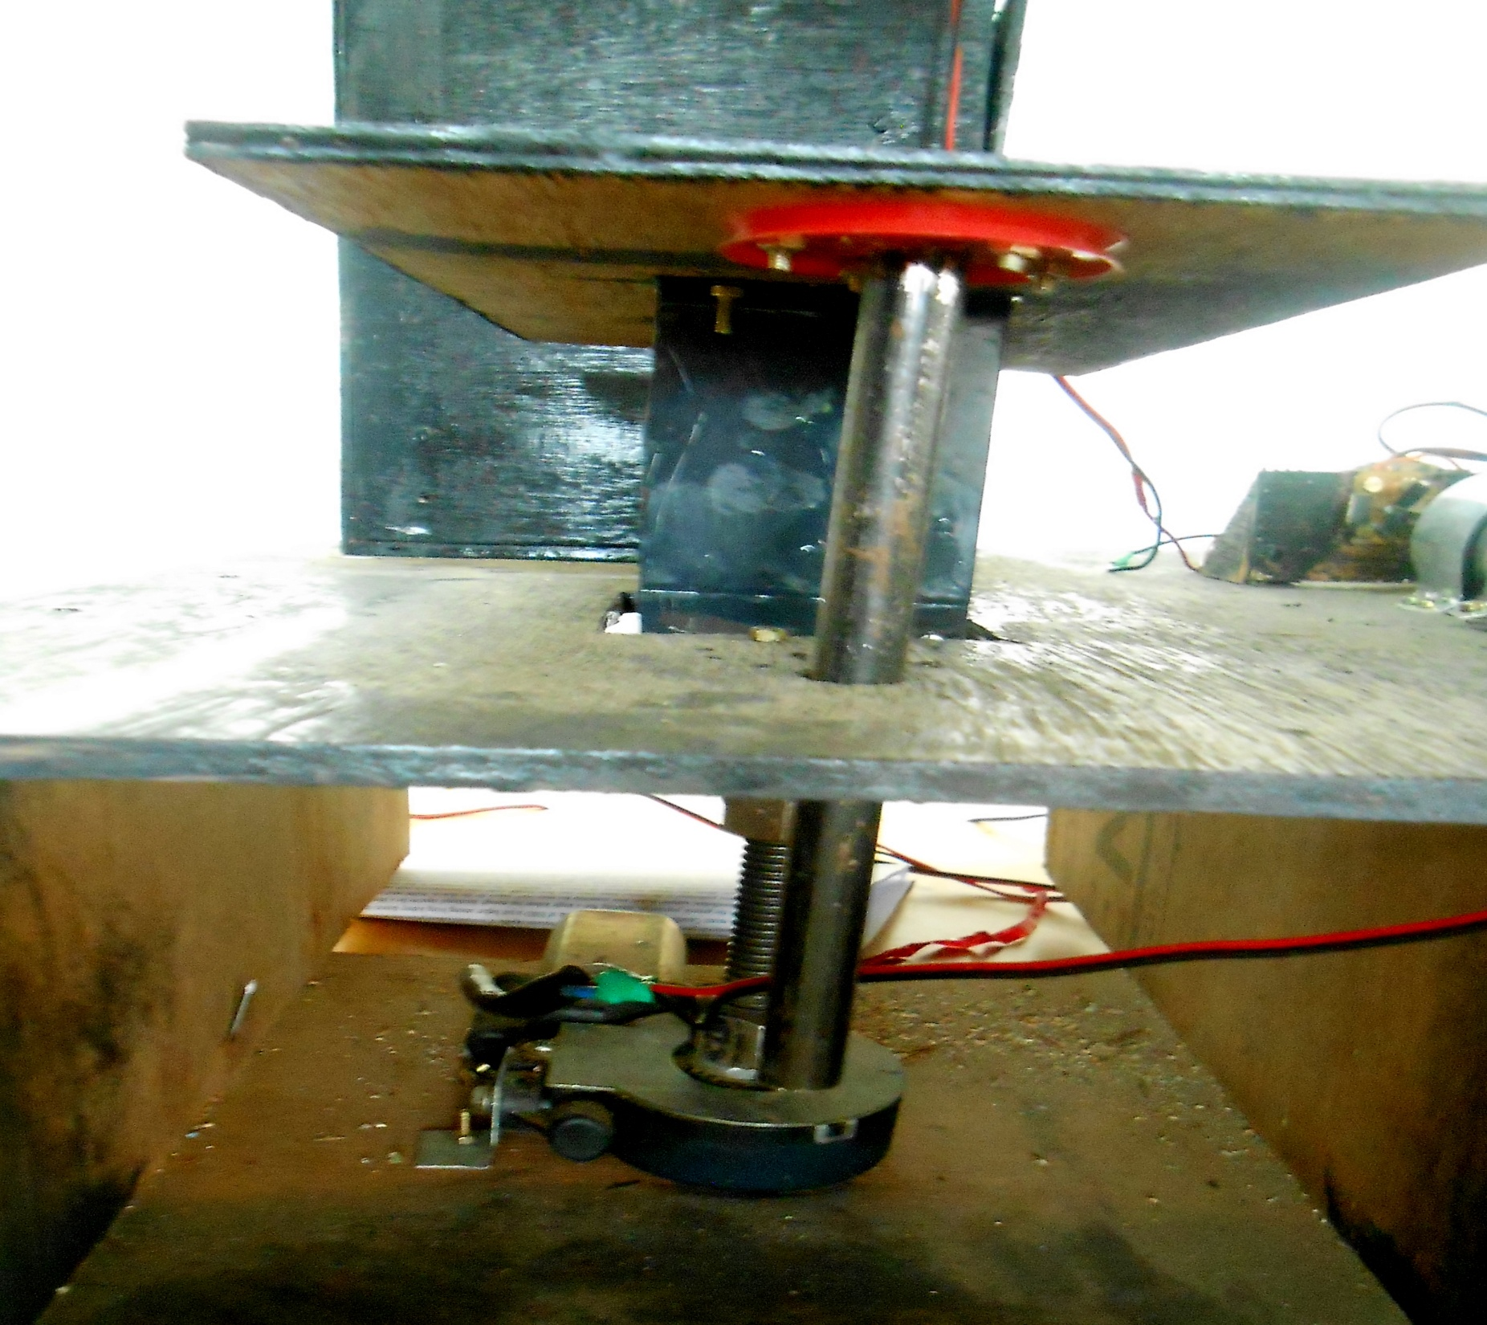

Slide 11
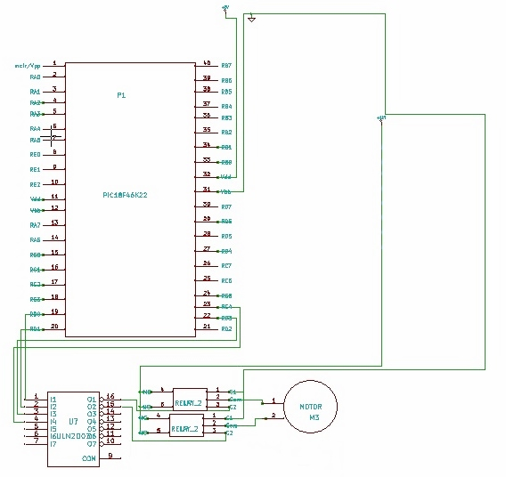
A
N
E
A
S
T
H
E
S
I
A
A
D
M
I
N

Slide 12
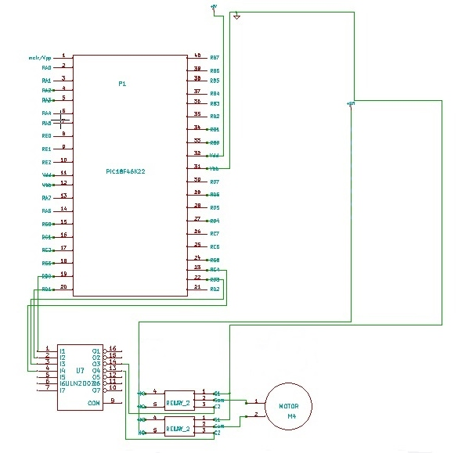
B
L
O
O
D
A
G
I
T
A
T
O
R

Slide 13
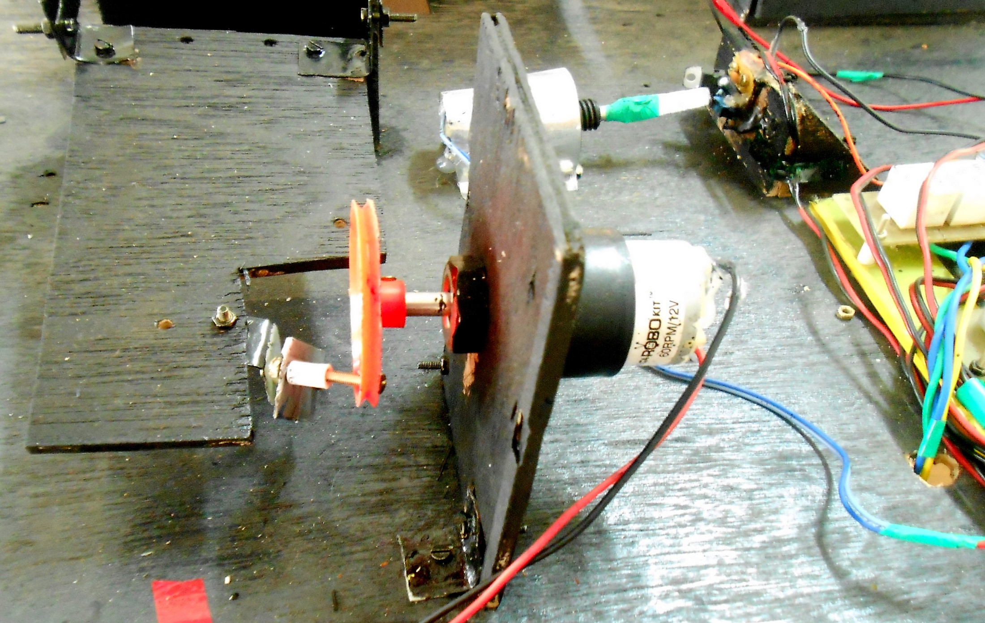

Slide 14
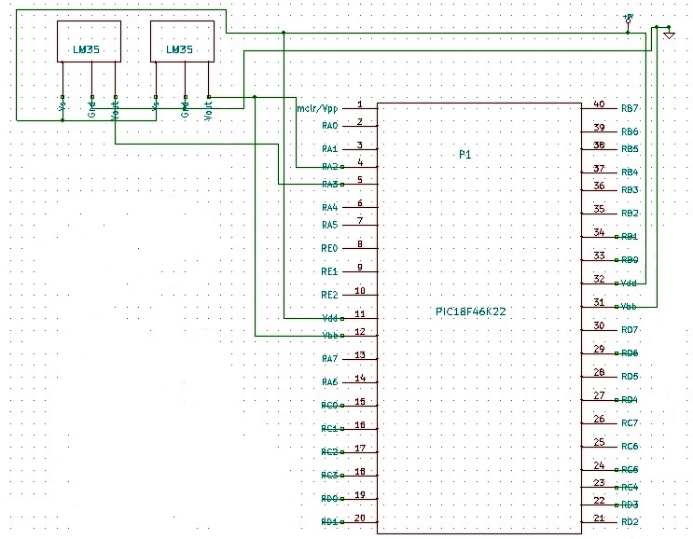
P
A
T
I
E
N
T
&
R
O
O
M
T
E
M
P

Slide 15
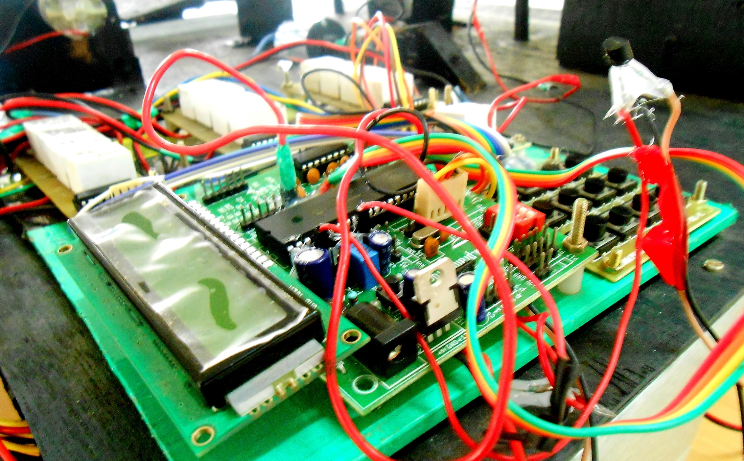

Slide 16
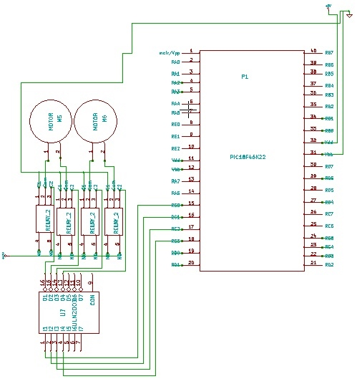
T
R
A
Y
S
E
L
E
C
T
I
O
N

Slide 17
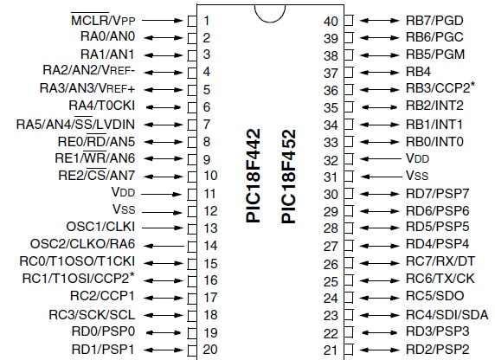
P
I
C
1
8
F
4
5
2

Slide 18
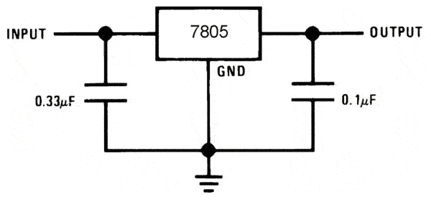
L
M
7
8
0
5
V
L
T
R
E
G
7805 is a voltage regulator integrated circuit.
It is a member of 78xx series of fixed linear voltage regulator ICs.
The voltage source in a circuit may have fluctuations and would not give the fixed voltage output.
The voltage regulator IC maintains the output voltage at a constant value.
The xx in 78xx indicates the fixed output voltage it is designed to provide.
7805 provides +5V regulated power supply.

Slide 19
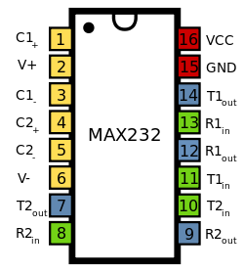
M A X 2 3 2 I C
The MAX220–MAX249 family of line drivers/receivers is intended for all EIA/TIA-232E and V.28/V.24 communications interfaces, particularly applications where ±12V is not available.
Meets or Exceeds TIA/EIA-232-F and ITU
Recommendation V.28
Operates From a Single 5-V Power Supply

Slide 20
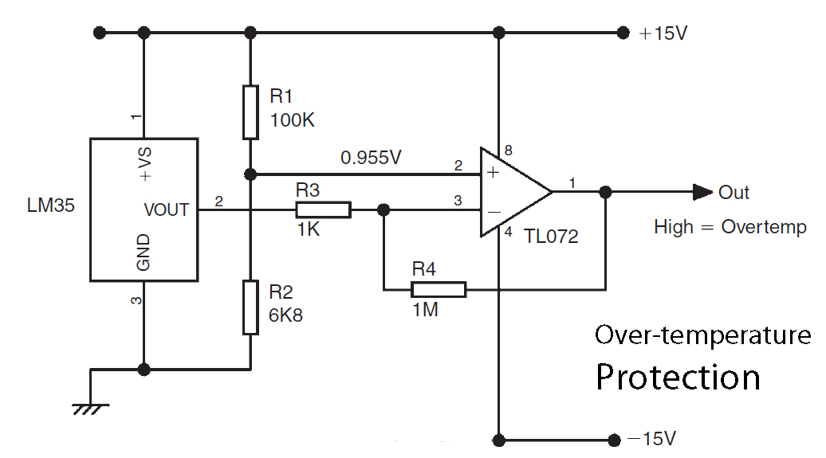
L
M
T
E
M
P
E
R
A
T
U
R
E
S
E
N
S
O
R

Slide 21
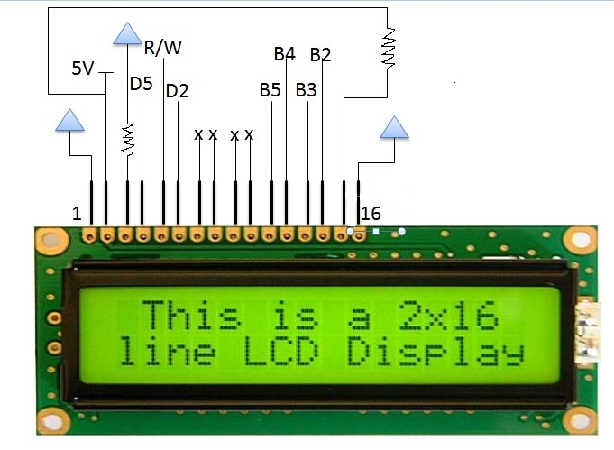
L
C
D
I
N T E R F A C E
220 ohm
220 ohm

Slide 22
U A R T D R I V E R S
The UART takes bytes of data and transmits the individual bits in a sequential fashion.
At the destination, a second UART re-assembles the bits into complete bytes.
Two types are :
UART Universal Asynchronous Receiver/Transmitter
USART Universal Synchronous-Asynchronous Receiver/Transmitter

Slide 23
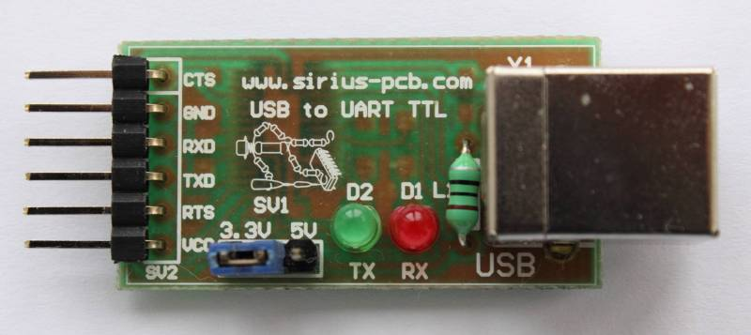
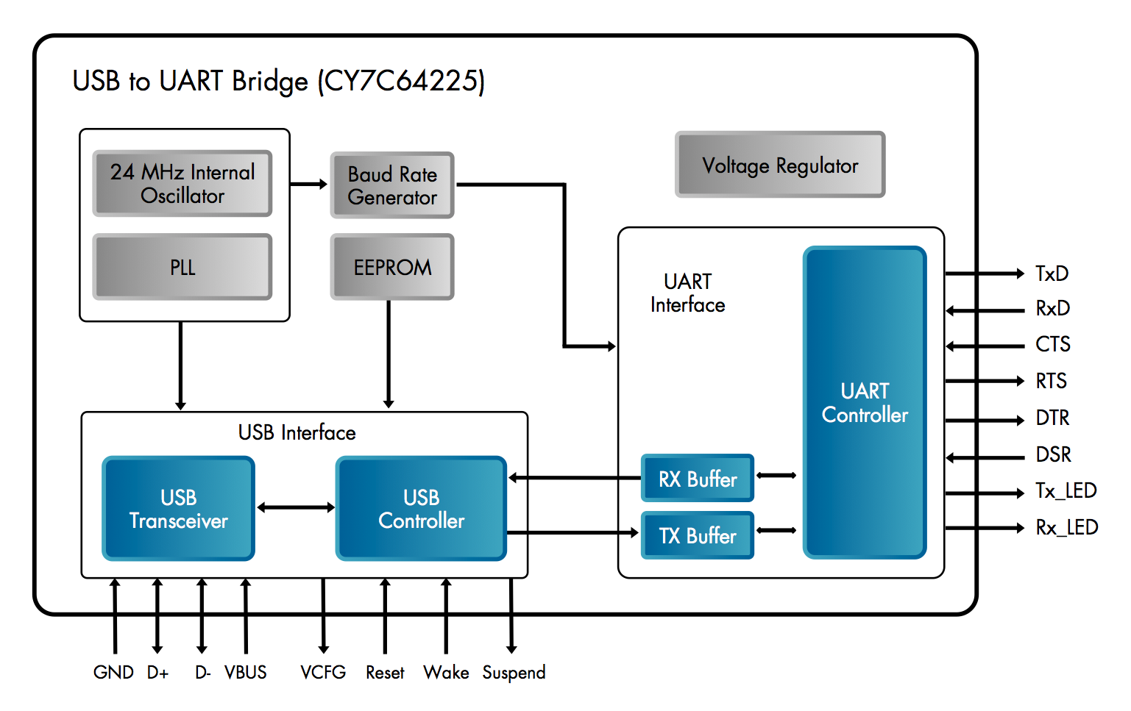
U S B T O U A R T D R I V E R S

Slide 24
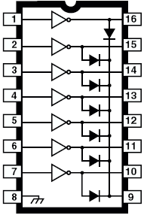
U L N 2 0 0 3
ULN 2003
500mA rated collector current(Single output)
High-voltage outputs: 50V
Inputs compatible with various types of logic.
Relay driver application.
The ULN2003 has a 2.7kW series base resistor for each Darlington pair for operation directly with TTL or 5V CMOS devices.

Slide 25
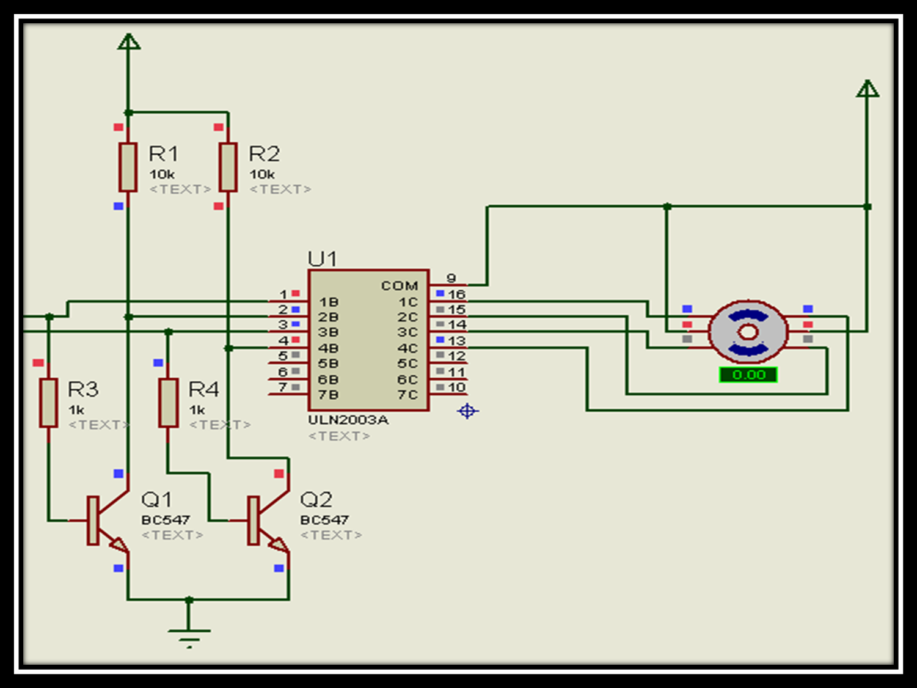
U L N 2 0 0 3 W I T H S T E P P E R M O T O R

Slide 26
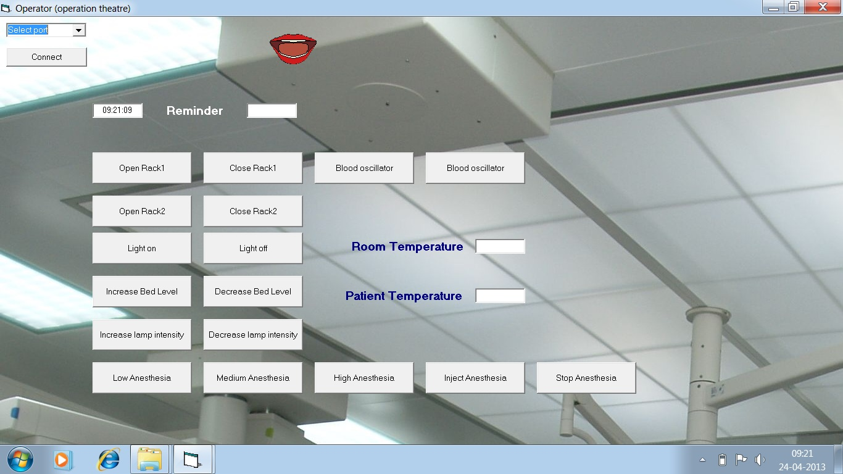
V B I N T E R F A C E

Slide 27
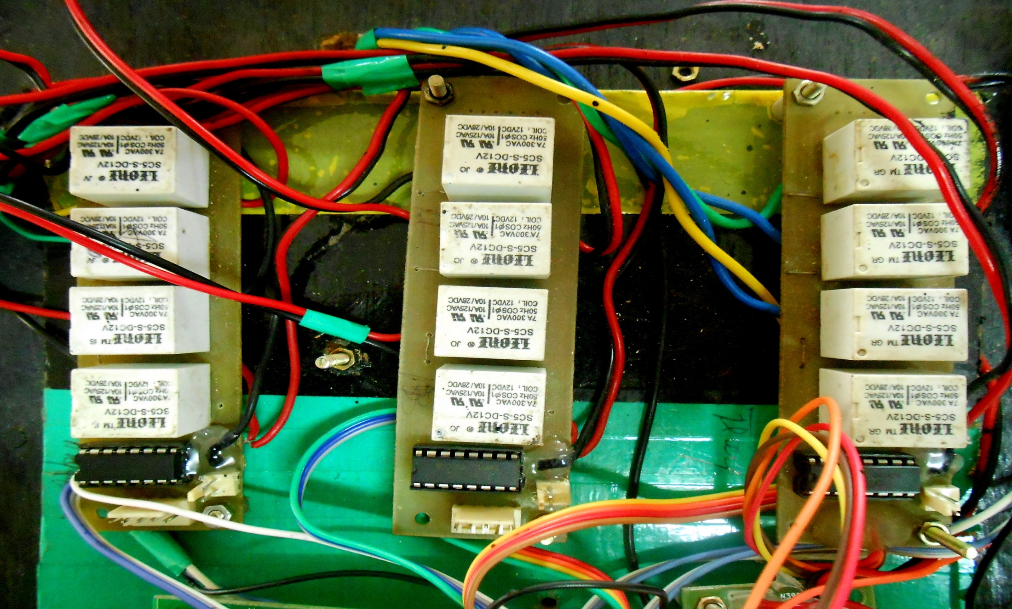

Slide 28
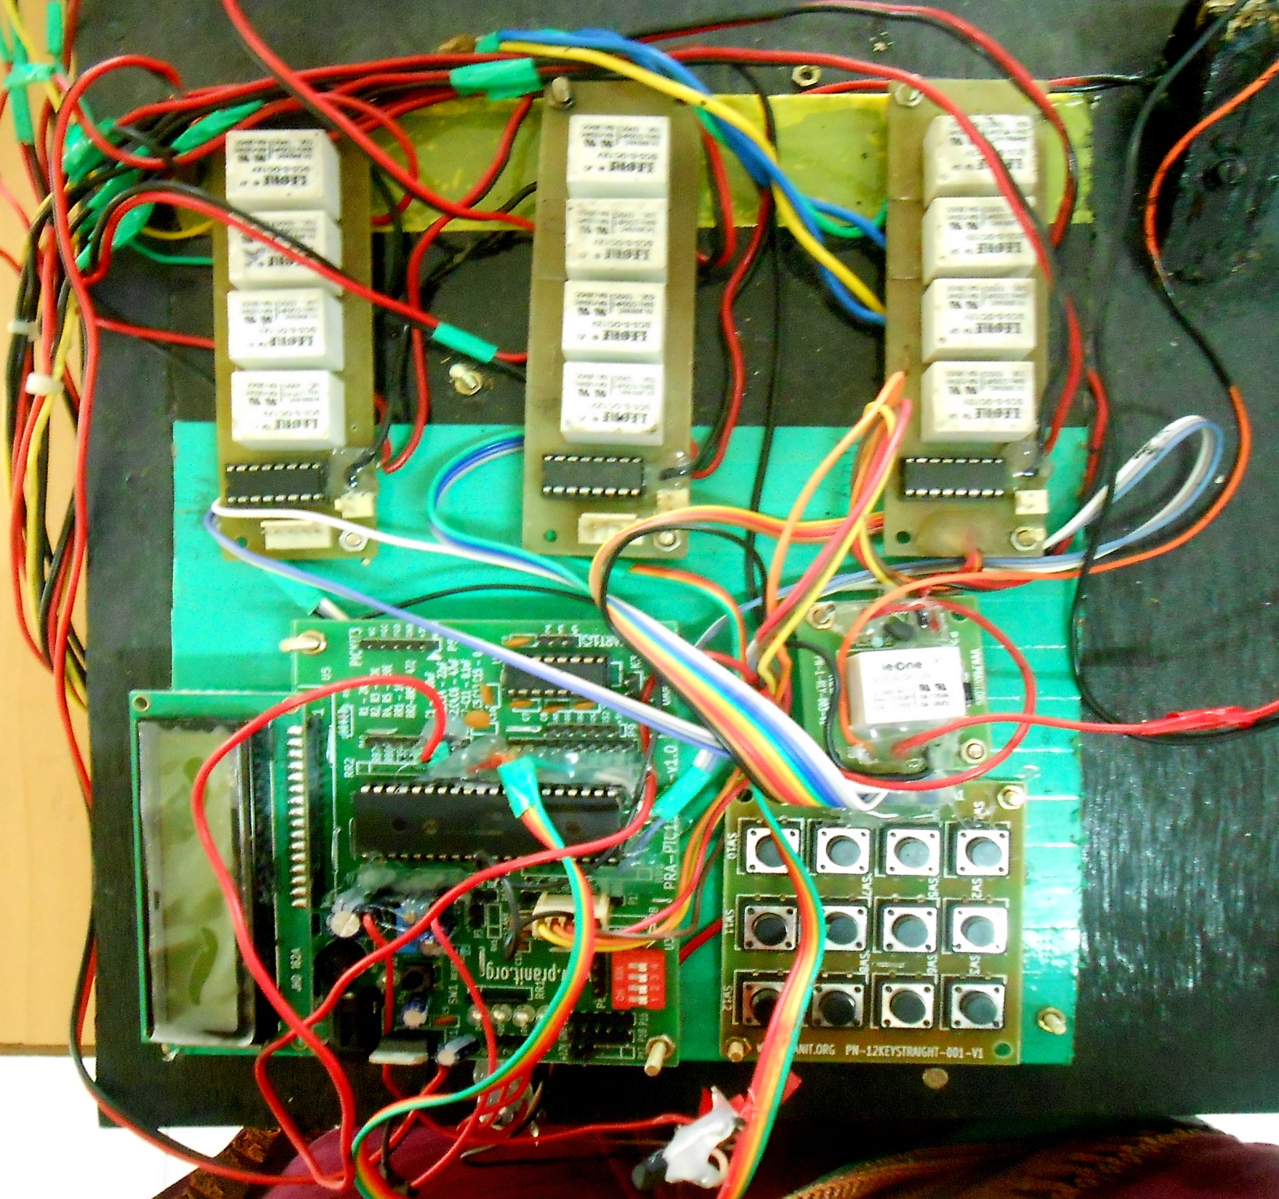

Slide 29
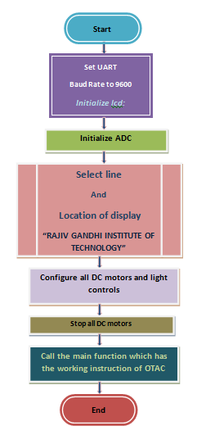
F
L
O
W
C
H
A
R
T

Slide 30
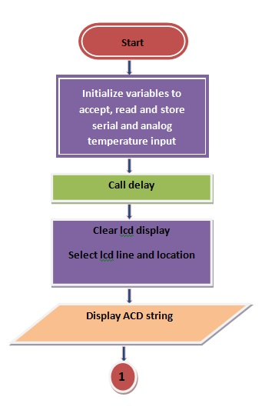
F
L
O
W
C
H
A
R
T

Slide 31
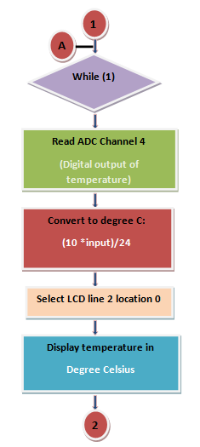
F
L
O
W
C
H
A
R
T

Slide 32
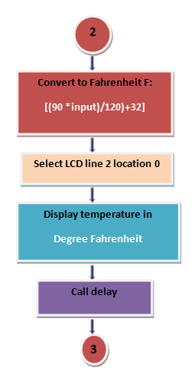
F
L
O
W
C
H
A
R
T

Slide 33
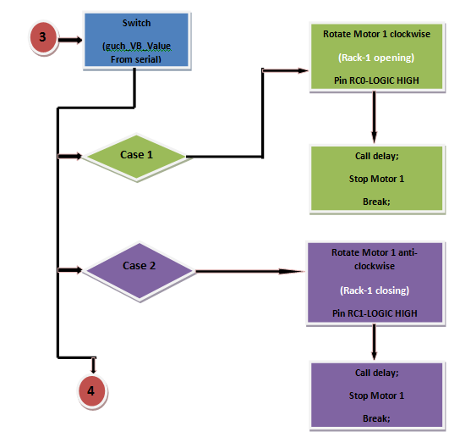
F
L
O
W
C
H
A
R
T

Slide 34
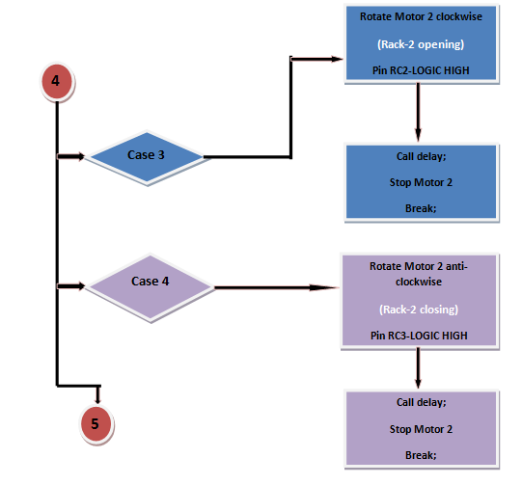
F
L
O
W
C
H
A
R
T

Slide 35
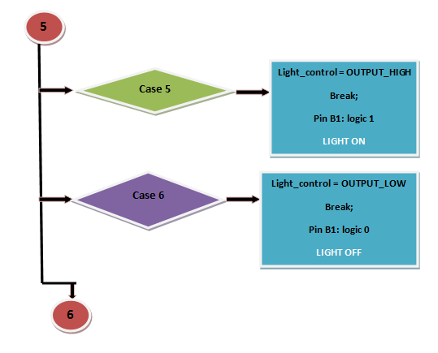
F
L
O
W
C
H
A
R
T

Slide 36
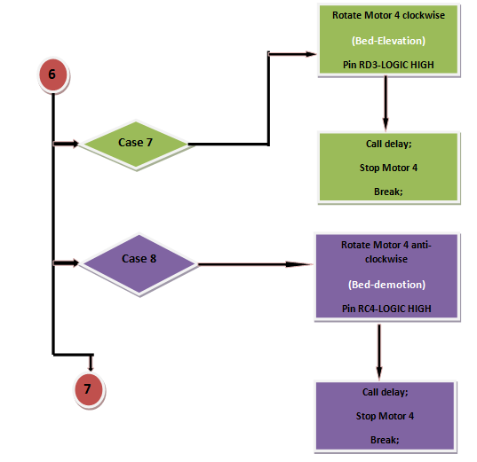
F
L
O
W
C
H
A
R
T

Slide 37
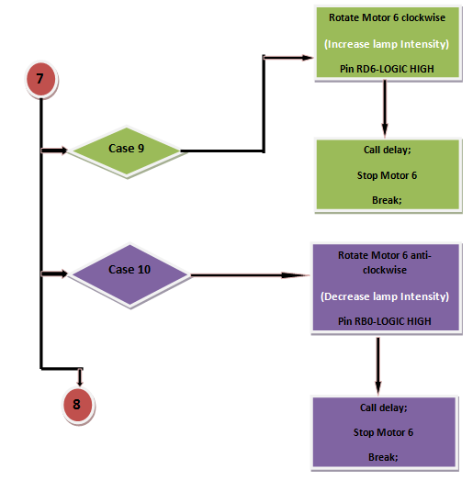
F
L
O
W
C
H
A
R
T

Slide 38
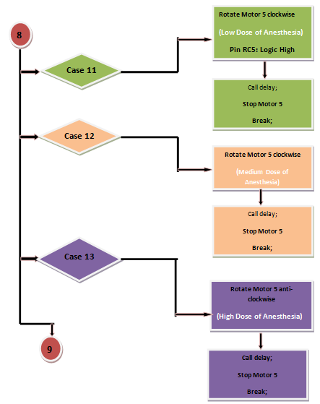
F
L
O
W
C
H
A
R
T

Slide 39
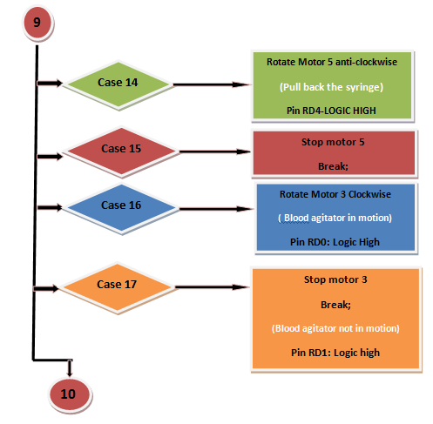
F
L
O
W
C
H
A
R
T

Slide 40
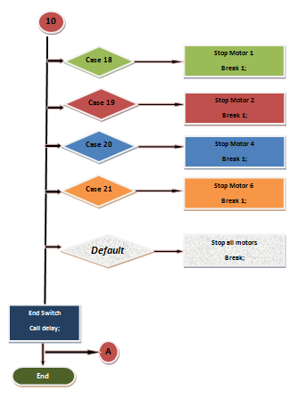
F
L
O
W
C
H
A
R
T

Slide 41
O
T A C C O D E S
#include <p18cxxx.h>
#include <stdio.h>
#include <string.h>
#include "main.h"
#include "ProjectMain.h"
#include "serial_codes.h"
#include "ADC.H"
#include "LCD.h"
#include "PinAllocation.h"
#include "delay.h"
#include "timers.h"
unsigned int gnTimer0Count=1, gnCount;
unsigned long bres=0;
unsigned char uchflag;
extern unsigned char guchCount;
extern unsigned char guchFlagForMotor;

Slide 42
O
T A C C O D E S
void main()
{
unsigned char uchWelcomeString[17] ="RAJIV GANDHI INT";
unsigned char uchAPSISString[17] =" OF TECHNOLOGY ";
unsigned char uchTempbuff=0;
guchCount=0;
fn_Initialize_Serial(BAUD_9600);
printf("System Booting\n\r");
lcd_16_2_Initialisation();
fnInitializeADC();
delay_in_seconds(1);
fn_lcd_select_line_and_location(LCD_LINE_1,LOCATION_0);
fn_Display_String_LCD(uchWelcomeString);
fn_lcd_select_line_and_location(LCD_LINE_2,LOCATION_0);
fn_Display_String_LCD(uchAPSISString);
delay_in_seconds(4);

Slide 43
O
T A C C O D E S
DC_Motor_1_Coil_0_DIR = SET_OUTPUT;
DC_Motor_1_Coil_1_DIR = SET_OUTPUT;
DC_Motor_2_Coil_0_DIR = SET_OUTPUT;
DC_Motor_2_Coil_1_DIR = SET_OUTPUT;
DC_Motor_3_Coil_0_DIR = SET_OUTPUT;
DC_Motor_3_Coil_1_DIR = SET_OUTPUT;
DC_Motor_4_Coil_0_DIR = SET_OUTPUT;
DC_Motor_4_Coil_1_DIR = SET_OUTPUT;
DC_Motor_5_Coil_0_DIR = SET_OUTPUT;
DC_Motor_5_Coil_1_DIR = SET_OUTPUT;
DC_Motor_6_Coil_0_DIR = SET_OUTPUT;
DC_Motor_6_Coil_1_DIR = SET_OUTPUT;
// DC_Motor_7_Coil_0_DIR = SET_OUTPUT;
// DC_Motor_7_Coil_1_DIR = SET_OUTPUT;
Light_Control_DIR = SET_OUTPUT;
Light_Control = OUTPUT_LOW;
Stop_All_DC_Motors();
fnMain_Project();
}

Slide 44
O
T A C P
I
N
A
L L
O
C
A
T
I
O
N
#include<p18f452.h>
// Pin allocation.h
#define DEBUGMODE 1
#define RELEASEMODE 0
#define MODE RELEASEMODE
#define DBGPRINTF if(MODE) printf
#define FAIL 0 // Used to return value as FAIL
#define PASS 1 // Used to return value as PASS
#define SET_INPUT 1 // Used to configure a pin as Input using TRIS statement
#define SET_OUTPUT 0 // Used to configure a pin as Output using TRIS statement
#define OUTPUT_HIGH 1 // TO make the output pin High
#define OUTPUT_LOW 0 // TO make the output pin Low

Slide 45
O
T A C P
I
N
A
L L
O
C
A
T
I
O
N
#define ON 0 // To put On any devices connected ex. LED
#define OFF 1 // To put Off any devices connected ex. LED
// Configuration of LCD pins: 4 data pins, RS pin and Enable pin
#define RS_lcd LATDbits.LATD5
#define Enable_lcd LATDbits.LATD2 // For Enabling the LCD.
#define lcd_d4_lsb LATBbits.LATB5 // pin 11 of LCD
#define lcd_d5 LATBbits.LATB4 // pin 12 of LCD
#define lcd_d6 LATBbits.LATB3 // pin 13 of LCD
#define lcd_d7_msb LATBbits.LATB2 // pin 14 of LCD

Slide 46
O
T A C P
I
N
A
L L
O
C
A
T
I
O
N
#define RS_lcd_dir TRISDbits.TRISD5
#define Enable_lcd_dir TRISDbits.TRISD2
#define lcd_d4_lsb_dir TRISBbits.TRISB5 // pin 11 of LCD DIR
#define lcd_d5_dir TRISBbits.TRISB4 // pin 12 of LCD DIR
#define lcd_d6_dir TRISBbits.TRISB3 // pin 13 of LCD DIR
#define lcd_d7_msb_dir TRISBbits.TRISB2 // pin 14 of LCD DIR
// For wheel Motor 1
#define DC_Motor_1_Coil_0_DIR TRISCbits.TRISC0
#define DC_Motor_1_Coil_1_DIR TRISCbits.TRISC1
// For wheel Motor 2
#define DC_Motor_2_Coil_0_DIR TRISCbits.TRISC2
#define DC_Motor_2_Coil_1_DIR TRISCbits.TRISC3
// Motor 3
#define DC_Motor_3_Coil_0_DIR TRISDbits.TRISD0
#define DC_Motor_3_Coil_1_DIR TRISDbits.TRISD1

Slide 47
O
T A C P
I
N
A
L L
O
C
A
T
I
O
N
// Motor 4
#define DC_Motor_4_Coil_0_DIR TRISDbits.TRISD3
#define DC_Motor_4_Coil_1_DIR TRISCbits.TRISC4
// Motor 5
#define DC_Motor_5_Coil_0_DIR TRISCbits.TRISC5
#define DC_Motor_5_Coil_1_DIR TRISDbits.TRISD4
// Motor 6
#define DC_Motor_6_Coil_0_DIR TRISDbits.TRISD6
#define DC_Motor_6_Coil_1_DIR TRISBbits.TRISB0
#define Light_Control_DIR TRISBbits.TRISB1
// For wheel Motor 1
#define DC_Motor_1_Coil_0 LATCbits.LATC0
#define DC_Motor_1_Coil_1 LATCbits.LATC1
// For wheel Motor 2
#define DC_Motor_2_Coil_0 LATCbits.LATC2
#define DC_Motor_2_Coil_1 LATCbits.LATC3

Slide 48
O
T A C P
I
N
A
L L
O
C
A
T
I
O
N
// Motor 3
#define DC_Motor_3_Coil_0 LATDbits.LATD0
#define DC_Motor_3_Coil_1 LATDbits.LATD1
// Motor 4
#define DC_Motor_4_Coil_0 LATDbits.LATD3
#define DC_Motor_4_Coil_1 LATCbits.LATC4
// Motor 5
#define DC_Motor_5_Coil_0 LATCbits.LATC5
#define DC_Motor_5_Coil_1 LATDbits.LATD4
// Motor 6
#define DC_Motor_6_Coil_0 LATDbits.LATD6
#define DC_Motor_6_Coil_1 LATBbits.LATB0

Slide 49
O
T A C P
I
N
A
L L
O
C
A
T
I
O
N
#define Light_Control LATBbits.LATB1
#define ADC_CHANNEL_1_DIR TRISAbits.TRISA0
#define ADC_CHANNEL_2_DIR TRISAbits.TRISA1
#define ADC_CHANNEL_3_DIR TRISEbits.TRISE2
#define ADC_CHANNEL_1 PORTAbits.RA0
#define ADC_CHANNEL_2 PORTAbits.RA1
#define ADC_CHANNEL_3 PORTEbits.RE2

Slide 50
O
T A C
M
A
I
N C O D E S
#include <p18cxxx.h>
#include <stdio.h>
#include <string.h>
#include "main.h"
#include "motor.h"
#include "timers.h"
#include "serial_codes.h"
#include "ADC.H"
#include "LCD.h"
#include "PinAllocation.h"
#include "delay.h"
//const unsigned char ADCString[17] ="PT.TEMP RM_TEMP";
const unsigned char ADCString[17] ="RM_TEMP PT.TEMP";
const unsigned char uchString_ROW1[17] = " ";
const unsigned char uchString_ROW2[17] = " ";
unsigned char guchCount;
unsigned char guchFlagForMotor;

Slide 51
void fnMain_Project()
{
unsigned char guch_VB_ValueFromSerial,nTempValue =0;
unsigned char uchArrayForString[10];
unsigned char uchTempBuff[16], uchSerialData=0;
unsigned int unBuff=0,unBuff3=0,unBuff1 = 0,unBuff2 = 0;
delay_in_seconds(1);
fn_clear_display();
fn_lcd_select_line_and_location(LCD_LINE_1,LOCATION_0);
fn_Display_String_LCD(ADCString);
while(1)
{
unBuff=unfnReadADCChannel(CHANNEL_4,ADC_MODE);
unBuff1 = (10*unBuff)/24;

Slide 52
printf("*%04u\n\r",(unsigned int)unBuff1);
sprintf(unBuff1,"%04u %cC",(unsigned int)unBuff1,(char)223);
fn_lcd_select_line_and_location(LCD_LINE_2,LOCATION_0);
fn_Display_String_LCD(unBuff1);
unBuff3=unfnReadADCChannel(CHANNEL_0,ADC_MODE);
unBuff2 = ((90*(unsigned int)unBuff3)/120)+32;
printf("#%04u\n\r",(unsigned int)(unBuff2));
sprintf(unBuff2,"%04u %cF",(unsigned int)unBuff2,(char)223);
fn_lcd_select_line_and_location(LCD_LINE_2,LOCATION_9);
fn_Display_String_LCD(unBuff2);
Delay_in_ms(200);

Slide 53
//-----------------------for device control--------------------------------------------//
PIE1bits.RCIE = 0; // Interrupt on receipt
guch_VB_ValueFromSerial = uchfnReceive_Serial_New();
if(guch_VB_ValueFromSerial == '*')
{
RCREG=0;
DBGPRINTF("Got *,Send number");
uchArrayForString[0] = uchfnReceive_Serial();
uchArrayForString[1] = uchfnReceive_Serial();
uchArrayForString[2] = 0;
DBGPRINTF("Converting\n\r");
guch_VB_ValueFromSerial = (unsigned char) atoi(uchArrayForString);
printf("%s, %d\n\r",uchArrayForString, (unsigned int)guch_VB_ValueFromSerial);

Slide 54
switch(guch_VB_ValueFromSerial)
{
case 1:
DC_Motor_1(DIR_COUNTER_CLOCKWISE);
DBGPRINTF("Motor 1 is runing anti clockwise\n\r");
strcpy(uchString_ROW1," MOTOR 1 STATUS" );
fn_lcd_select_line_and_location(LCD_LINE_2,LOCATION_12);
fn_Display_String_LCD(uchString_ROW1);
strcpy(uchString_ROW2,"MOTOR 1 CL. WISE");
fn_lcd_select_line_and_location(LCD_LINE_2,LOCATION_12);
fn_Display_String_LCD(uchString_ROW2);
delay_in_seconds(1);
DC_Motor_1_Stop();
DBGPRINTF("Motor 1 is stopped\n\r"); break;

Slide 55
case 2:
DC_Motor_1(DIR_CLOCK_WISE);
DBGPRINTF("Motor 1 is runing clockwise\n\r");
strcpy(uchString_ROW1," MOTOR 1 STATUS" );
fn_lcd_select_line_and_location(LCD_LINE_2,LOCATION_12);
fn_Display_String_LCD(uchString_ROW1);
strcpy(uchString_ROW2,"MOTOR 1 ACL WISE");
fn_lcd_select_line_and_location(LCD_LINE_2,LOCATION_12);
fn_Display_String_LCD(uchString_ROW2);
delay_in_seconds(1);
delay_in_half_seconds(1);
DC_Motor_1_Stop();
DBGPRINTF("Motor 1 is stopped\n\r");
break;

Slide 56
case 3:
DC_Motor_2(DIR_COUNTER_CLOCKWISE);
DBGPRINTF("Motor 2 is runing anti clockwise\n\r");
delay_in_seconds(1);
DC_Motor_2_Stop();
DBGPRINTF("Motor 2 is stopped\n\r");
break;
case 4:
DC_Motor_2(DIR_CLOCK_WISE);
DBGPRINTF("Motor 2 is runing clockwise\n\r");
strcpy(uchString_ROW1," MOTOR 2 STATUS" );
fn_lcd_select_line_and_location(LCD_LINE_2,LOCATION_12);
fn_Display_String_LCD(uchString_ROW1);
strcpy(uchString_ROW2,"MOTOR 2 CL. WISE");
fn_lcd_select_line_and_location(LCD_LINE_2,LOCATION_12);
fn_Display_String_LCD(uchString_ROW2);

Slide 57
delay_in_seconds(1);
delay_in_half_seconds(1);
DC_Motor_2_Stop();
DBGPRINTF("Motor 2 is stopped\n\r");
break;
case 5:
Light_Control = OUTPUT_HIGH;
DBGPRINTF("Light on\n\r");
break;
case 6:
Light_Control = OUTPUT_LOW;
DBGPRINTF("Light off\n\r");
break;
case 7:
DC_Motor_4(DIR_CLOCK_WISE);
DBGPRINTF("Motor 4 is runing clockwise\n\r");
delay_in_seconds(50);
DC_Motor_4_Stop();
DBGPRINTF("Motor 4 is stopped\n\r");
break;

Slide 58
case 8:
DC_Motor_4(DIR_COUNTER_CLOCKWISE);
DBGPRINTF("Motor 4 is runing anti clockwise\n\r");
delay_in_seconds(50);
DC_Motor_4_Stop();
DBGPRINTF("Motor 4 is stopped\n\r");
break;
case 9:
DC_Motor_6(DIR_COUNTER_CLOCKWISE);
DBGPRINTF("Motor 6 is runing anti clockwise\n\r");
delay_in_seconds(25);
DC_Motor_6_Stop();
DBGPRINTF("Motor 6 is stopped\n\r");
break;
case 10:
DC_Motor_6(DIR_CLOCK_WISE);
DBGPRINTF("Motor 6 is runing clockwise\n\r");
delay_in_seconds(25);
DC_Motor_6_Stop();
DBGPRINTF("Motor 6 is stopped\n\r");
break;

Slide 59
case 11:
DC_Motor_5(DIR_CLOCK_WISE);
DBGPRINTF("Motor 5 is runing clockwise\n\r");
delay_in_seconds(9);
DC_Motor_5_Stop();
DBGPRINTF("lOW DOSE OF ANESTHESIA\n\r");
break;
case 12:
DC_Motor_5(DIR_CLOCK_WISE);
DBGPRINTF("Motor 5 is runing clockwise\n\r");
delay_in_seconds(18);
DC_Motor_5_Stop();
DBGPRINTF("MEDIUM DOSE OF ANESTHESIA\n\r");
break;
case 13:
DC_Motor_5(DIR_CLOCK_WISE);
DBGPRINTF("Motor 5 is runing clockwise\n\r");
delay_in_seconds(27);
DC_Motor_5_Stop();
DBGPRINTF("FULL DOSE OF ANESTHESIA\n\r");
break;

Slide 60
case 14:
DC_Motor_5(DIR_COUNTER_CLOCKWISE);
DBGPRINTF("ENJECT DO OF ANESTHESIA\n\r");
case 15:
DC_Motor_5_Stop();
DBGPRINTF("STOP CYRING INJECTING\n\r");
break;
case 16:
DC_Motor_3(DIR_CLOCK_WISE);
DBGPRINTF("Motor 3 is runing clockwise\n\r");
break;
case 17:
DC_Motor_3_Stop();
DBGPRINTF("Motor 3 is runing stopped\n\r");
break;

Slide 61
case 18:
DC_Motor_1_Stop();
DBGPRINTF("Motor 1 is stopped\n\r");
strcpy(uchString_ROW1," MOTOR 1 STATUS" );
fn_lcd_select_line_and_location(LCD_LINE_2,LOCATION_12);
fn_Display_String_LCD(uchString_ROW1);
strcpy(uchString_ROW2," MOTOR 1 STOPPED");
fn_lcd_select_line_and_location(LCD_LINE_2,LOCATION_12);
fn_Display_String_LCD(uchString_ROW2);
break;
case 19:
DC_Motor_2_Stop();
DBGPRINTF("Motor 2 is stopped\n\r");
break;

Slide 62
case 20:
DC_Motor_4_Stop();
DBGPRINTF("Motor 4 is stopped\n\r");
break;
case 21:
DC_Motor_6_Stop();
DBGPRINTF("Motor 6 is stopped\n\r");
break;
default:
Stop_All_DC_Motors();
DBGPRINTF("STOP ALL DC MOTORS\n\r");
break;
}
}
delay_in_seconds(1);
}
}

Slide 63
A
D
V
A
N
T
G
O
U
S
& D
I
S
A
D
V
A
T A G O U S
Automation
1. Reduces surgeon’s workload.
2. Easy to operate with key or GUI controls.
Reduced complexity
1. Integrated parameter monitoring.
2. Increasing impact of surgery.
Time & manpower
1. Reduces time of surgeon such that some tasks are automated.
2. Limits the use of number of medical personnels.
DISADVANTAGES
OTAC needs prior training ,
Role of anaesthesiologist cannot be fully automated.
OTAC technician is mandatory.

Slide 64
CONCLUSION
Standardization of the healthcare organization
Increases the efficiency and performance of the surgical team
OTAC widens scope for further technological advancements

Slide 65

Thank You

